Slide 1




WEB
DEVELOPMENT
Learn how to create and develop your own website using HTML CSS

Slide 2



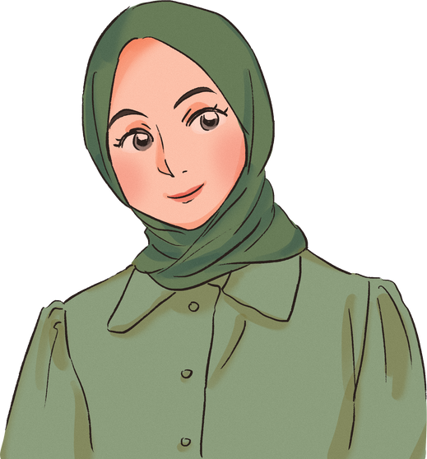

Meet
Name
Wafa
the
TEAM
Name
Sabrine

Slide 3

Cours
OBJECTIVES
1
Get to learn more about cybersecurity, internet, networks and web in general
2
Learn about HTML and CSS
3
Creating a website

Slide 4







WHY
CODING?

Slide 5


Increase creativity
Problem-solving
Do Wonder
Makes the impossible possible
The Future
Its FUN !!

Slide 6


are
you
ready?

Slide 7


WEB
OVERVIEW
What is it ?

Slide 8




one
round
At first i used to think that the internet was some magic trick created by certain wizard , or a human that lives inside my PC ... But while getting older I realized Iwas kinda wrong
indeed it was a certain magic but not the same one in my head .

Slide 9
Network
A computer network is a group of two or more computers that are linked together. Networks are usually used to share resources, exchange files or communicate with other users

Slide 10
Network
LAN
WAN
A Local Area Network (LAN) connects computers that are close together and have a short distance such as homes, schools etc ....
A Wide Area Network (WAN) connects computers that are close together and have a vast distance such as a continent. The largest WAN is the internet

Slide 11
INTERNET
So the internet is a wide area network that links computers that are exchanging data with each other
BUT HOW DOEA IT REALLY WORK ?

Slide 12
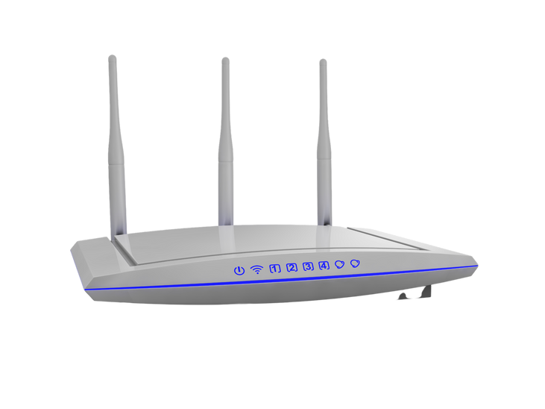
INTERNET
What looks easy from the outside is actually hard from the inside the messages we send are too hard for the internet to carry such a enormous package so to make it easier on it we split that package into a smaller packages which will be carried and sent to the receiver thro the help of the ROUTER
Whats a router ?

Slide 13
Internet
it helps transfaring those data between computers from a sender to the receiver with an IP Adress just like you have your home address PC have also a unique addresses,
when the router receive the packages it reads the IP address and send it it the right destination by following certain roles similaire to the traffic roles

Slide 14
internet
sheet
And thats how the internet works !!

Slide 15
Browser
WEBSITE
DEFINITIONs

Slide 16
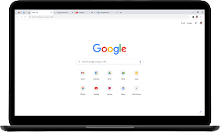
Browser
Its a brogram we use to view internet websites

Slide 17

WEBSITE
WEB pages we visit on the internet

Slide 18

SEARCH
ENGINE
WEB pages we use to seach information about something and then access all the information there's on the internet

Slide 19

CYBER
SECURITY
HOW DOES IT WORK?

Slide 20

CYBER
SEC
The internet may be the best place to get information and to learn more about basically everything but it can be also a dark mysterious sea that you can get in a lot of troubles if you didn't know how to use it correctly that's why there is something called
CYBER SECURITY- INTERNET SECURITY

Slide 21
CYBER
SEC
Lets watch and observe this video
https://www.youtube.com/watch?v=yiKeLOKc1tw
Can you tell me what the boy is doing ?

Slide 22
CYBER
SEC
Social enginneering
social engineering is the psychological manipulation of people into performing actions or divulging confidential information.

Slide 23
CYBER
SEC
OSINT- Open source intelligence
The art of collecting data from open source places such as the internet in order to use them against you

Slide 24
CYBER
SEC
Phishing
attack that attempts to steal your money, or your identity, by getting you to reveal personal information -- such as credit card numbers, bank information, or passwords -- on websites that pretend to be legitimate.

Slide 25

Staying
safe
Update your web browser
Stop visiting websites without HTTPS
Be careful what files/applications you download
Save your passwords in a safe place
Do not share sensitive information
Use VPN
Don't talk to strangers

Slide 26

HTML
CSS
LETS GOOOO !!

Slide 27

HTML
CSS
PROGRAMMING LANGUAGES
Like we human use our own language to communicate with each other , we need a certain language to communicate with our Pc and Computer ! that's why we have what is called
Programming languages are what help us make the impossible possible, there are many programming languages such as python , java , C and others that helps us create and design websites games and application

Slide 28
HTML
CSS
PROGRAMMING LANGUAGES
in today lesson we gonna lean HTML CSS 2 design languages that are going to help us in creating a simple website like this

Slide 29
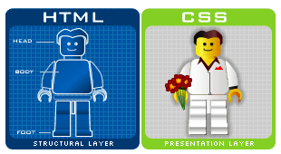
HTML and CSS
BORING NOTHING MUCH TO SEE
DESIGN COLORFUL MORE INTERSTING

Slide 30
HTML
CSS
We need both HTML and CSS to help us make really cool websites

Slide 31
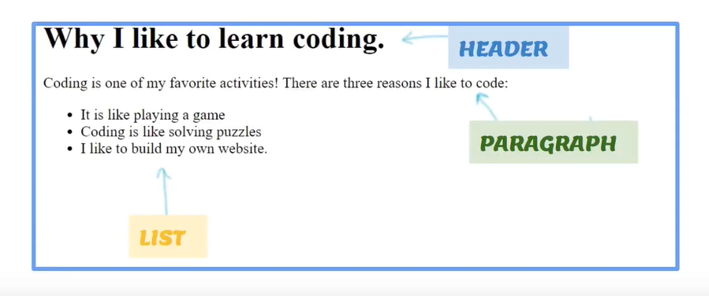
HTML
CSS
The basics

Slide 32
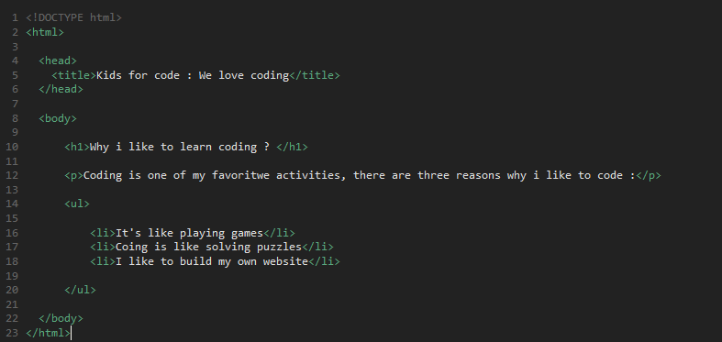
The Code

Slide 33
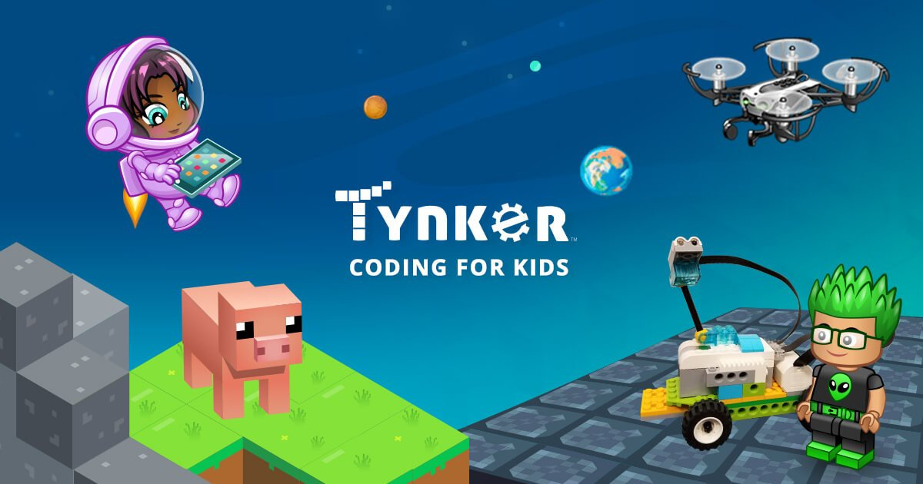
Tools

Slide 34
Getting started : Tags / Elements
HTML uses " tags " which are angled brackets < ... > .
The tags have letters that are directions for the computer
< hr >
tells the browser to display a horizontal line . These words are called elements .
- Most tags come in pairs :
< html >
< / html >
Keep lowercase !

Slide 35
PAGE
STRUCTURE

Slide 36
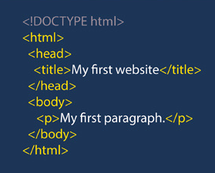
DOCUMENT TYPE
< ! doctype html >
Empty tag ( no closing )
Tells browser what type of document the webpage is
html : Hyper Text Markup Language
Specifically HTML5

Slide 37
HTML TAG
< html > ... < / html >
Every HTML document begins and ends with the < html > tag
This tells the browser that the following document is an html file
Surround everything else on page
Remember , tags tell the browsers how to display information

Slide 38
HEAD TAG
< HEAD> ... < / hEAD >
contains the title of the document along with some general information about it such as the author, copyrights etc ...

Slide 39
TITLE TAG
< title > ... < / title >
Appears within the < head > tags and gives the title of the page
The title appears at the very top of the browser page on the title tab
Used in search engine results
Try to make your titles descriptive , but not more than 20 words in length

Slide 40
BODY TAG
< body > ... < / body >
The main content of your page is placed within the body tags : your text , images , links , tables and so on

Slide 41
USUAL
HTML TAGS

Slide 42
<P> TAG
<P>
IT defines a paragraph
Automatically creates some space before and after itself
Example
< body >
<p> This is some text in a paragraph . < / p >
<p> This is more text in a paragraph . < / p >
< / body >
OUTPUT:
This is some text in a paragraph .
This is more text in a paragraph .

Slide 43

<h> TAG
< h1 > - < h6 >
Define headings
< h1 > is Most important
< h6 > is Least important
<h1>
<h2>
<h3>
<h4>
<h5>
<h6>

Slide 44
Example
< body >
< h1 > This is header 1 < / h1 >
< h2 > This is header 2 < / h2 >
< h3 > This is header 3 < / h3 >
< h4 > This is header 4 < / h4 >
< h5 > This is header 5 < / h5 >
< h6 > This is header 6 < / h6 >
< / body >
OUTPUT:
This is header 1
This is header 2
This is header 3
This is header 4
This is header 5
This is header 6

Slide 45
<br/> TAG
Inserts a single line break
Empty tag - it has no end tag
Use to enter blank lines , NOT to separate paragraphs
Example
< body >
This text contains <br/> a line break .
< / body >
OUTPUT:
This text contains
a line break .

Slide 46
<hr/> TAG
Creates horizontal rule ( line ) AND Defines a separation of content ( change ) - a thematic break
Empty tag - it has no end tag
Example
< body >
< h1 > HTML < / h1 >
< p > HTML is a language for describing web pages < / p >
< hr / >
< h1 > Browser < / h1 >
< p > A browser is the piece of software used to view a web page . < / p >
< / body >

Slide 47
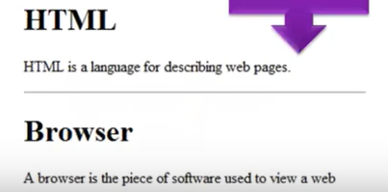
<hr/> TAG
Creates horizontal rule ( line ) AND Defines a separation of content ( change ) - a thematic break
Empty tag - it has no end tag
OUTPUT :

Slide 48
<b> TAG
Originally " b " short for " Bold "
Default : makes text look bold
Makes text have different style from the rest without meaning " extra important "
Example
< body >
< p > It was a < b > red < / b > house with a < b > blue < / b > door . < / p >
< / body >
OUTPUT:
It was a red house with a blue door .

Slide 49

thaTS
ALL
for
TODAY

